Slide 1
Atopic Dermatitis Peer-to-Peer Educational Toolkit
A compilation of key content from select presentations at the 2020 South Beach Symposium and the Masters of Pediatric Dermatology
Lawrence A. Schachner, M.D
Professor, Chair Emeritus and Stiefel Laboratories Chair
Director of the Division of Pediatric Dermatology
Department of Dermatology & Cutaneous Surgery
Professor, Department of Pediatrics Leonard M. Miller School of Medicine
University of Miami
Leon H. Kircik M.D.
Clinical Associate
Professor of Dermatology
Indiana University School of Medicine
Mount Sinai Medical Center, New York, NY
Physicians Skin Care, PLLC
Louisville, KY
Fernanda Bellodi Schmidt, MD
Assistant Professor
Department of Dermatology and Cutaneous Surgery
University of Miami Health Systems
David E. Cohen, M.D., M.P.H.
Charles and Dorothea Harris Professor
and Vice Chairman for Clinical Affairs
Director of Allergic, Occupational and Environmental Dermatology
New York University School of Medicine Department of Dermatology

Slide 2
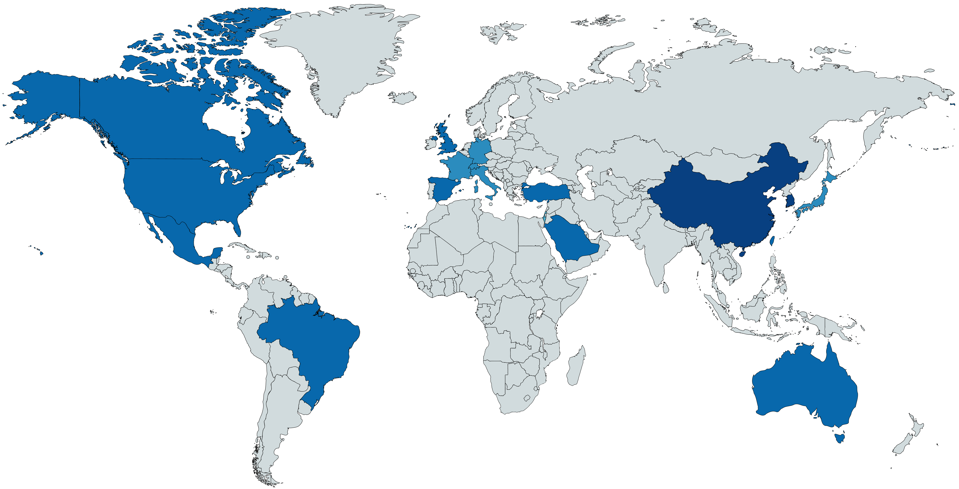
A global epidemiology survey of the prevalence and severity of AD: All patients
Canada
Germany
9%
6%
UK
10%
Italy
China
South Korea
8%
14%
14%
France
USA
7%
Turkey
9%
12%
Japan
Spain
Switzerland
6%
11%
5%
Mexico
Taiwan
12%
Saudi Arabia
9%
Israel
10%
3%
All ages (0–18+)
0–4%
5–8%
9–12%
13–16%
Brazil
11%
Australia
10%
Silverberg J, et al. EADV 2018, FC01.01. Sponsored by Pfizer
David E. Cohen, M.D.

Slide 3
Hannifin Criteria: Major criteria (need 3 or more) are as follows:
Pruritus
Typical morphology and distribution
Flexural lichenification in adults
Facial and extensor involvement in infants and children
Dermatitis - Chronically or chronically relapsing
Personal or family history of atopy (asthma, allergic rhinitis, atopic dermatitis)
J Dermatol. 2016 Apr;43(4):376-84. doi: 10.1111/1346-8138.13264.
David E. Cohen, M.D.

Slide 4
Hannifin Criteria: Minor criteria (need 3 or more) are as follows:
Cataracts
Cheilitis
Conjunctivitis - Recurrent
Eczema - Perifollicular accentuation
Facial pallor or erythema
Food intolerance
Hand dermatitis - Nonallergic
Ichthyosis
IgE – Elevated
Immediate (type I) skin test reactivity
Infections (cutaneous)
Dennie-Morgan infraorbital fold
Itching when sweating
Keratoconus
Keratosis pilaris
Nipple dermatitis
Orbital darkening
Palmar hyperlinearity
Pityriasis alba
White dermographism
Wool intolerance
Xerosis
J Dermatol. 2016 Apr;43(4):376-84. doi: 10.1111/1346-8138.13264.
David E. Cohen, M.D.

Slide 5
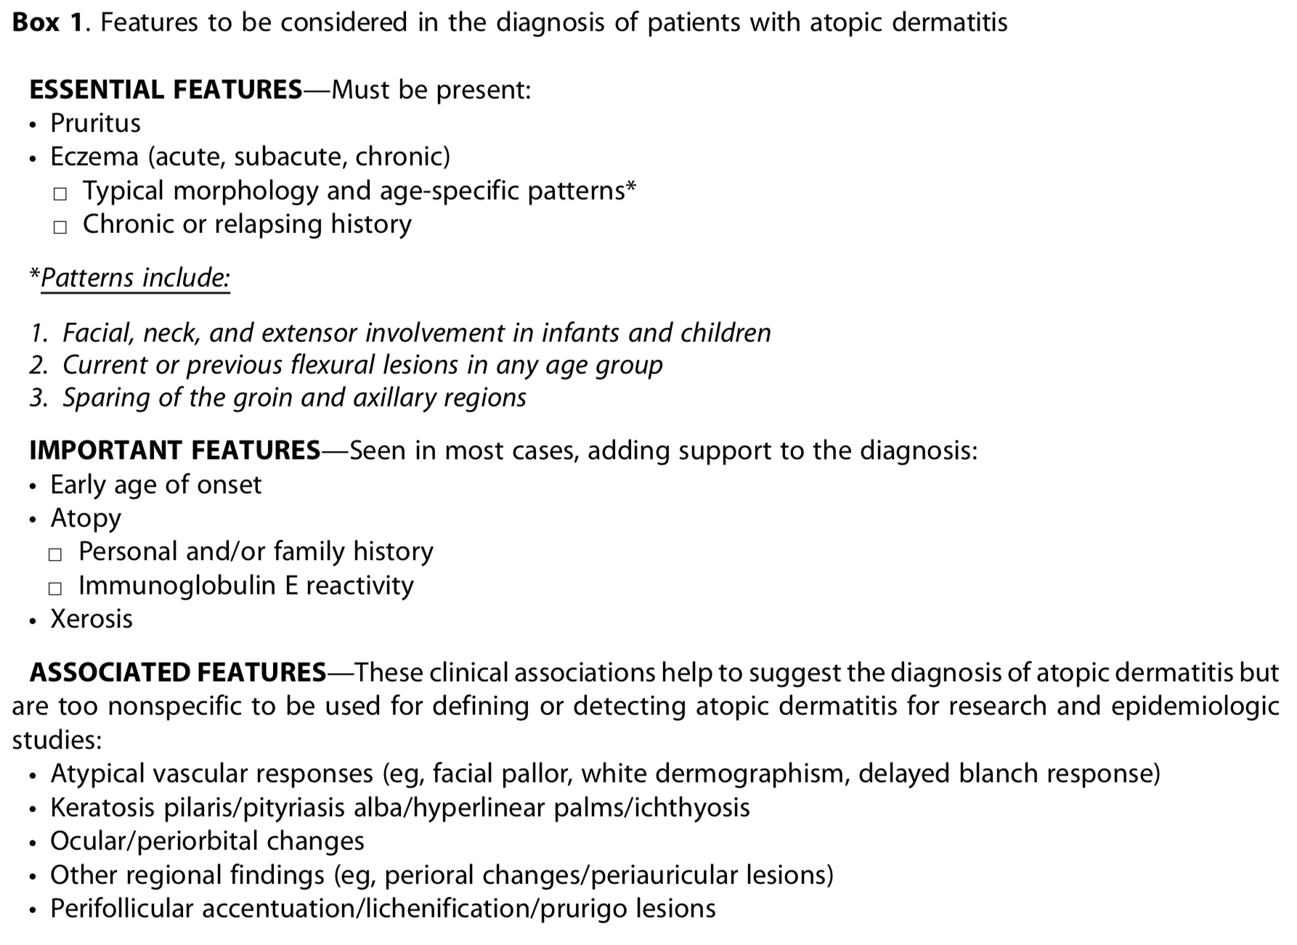
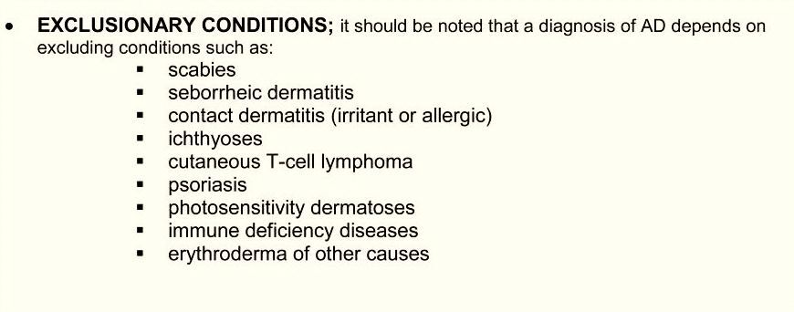
Guidelines for the management of atopic dermatitis – Diagnosis and Assessment
J Am Acad Dermatol. 2014 Feb; 70(2): 338–351.
David E. Cohen, M.D.

Slide 6
Atopic Dermatitis – co-factors
Purported influencing factors
prenatal exposures
Irritants
pruritogens
pathogens
climate factors
temperature
humidity
ultraviolet radiation
outdoor and indoor air pollutants
tobacco smoke exposure,
water hardness
urban vs. rural living
diet
breastfeeding
probiotics and prebiotics
Adult AD cohort had a significantly higher prevalence of;
nasal allergies (46.4% vs. 19.8%)
asthma (22.4% vs. 7.9%),
neuropsychiatric conditions such as anxiety (42.5% vs. 21.3%)
depression (37.2% vs. 20.9%) (all P < 0.0001).
Higher resource use (healthcare practitioner visits, emergency room, hospitalizations) (P < 0.05
~33%
Asthma
Eczema
~38%
AR
~33%
Expert Rev Clin Immunol. 2016 Jul 28:1-12. [Epub ahead of print]Curr Med Res Opin. 2016 Jun 21:1-7. [Epub ahead of print]
David E. Cohen, M.D.

Slide 7
Two Major Hypotheses on Development of Inflammation
Primary defect in epithelial barrier
Secondary immunologic dysregulation
Inflammation
Outside-Inside View
Inside-Outside View
Primary immune dysfunction
IgE sensitization and secondary epithelial-barrier disturbance
David E. Cohen, M.D.

Slide 8
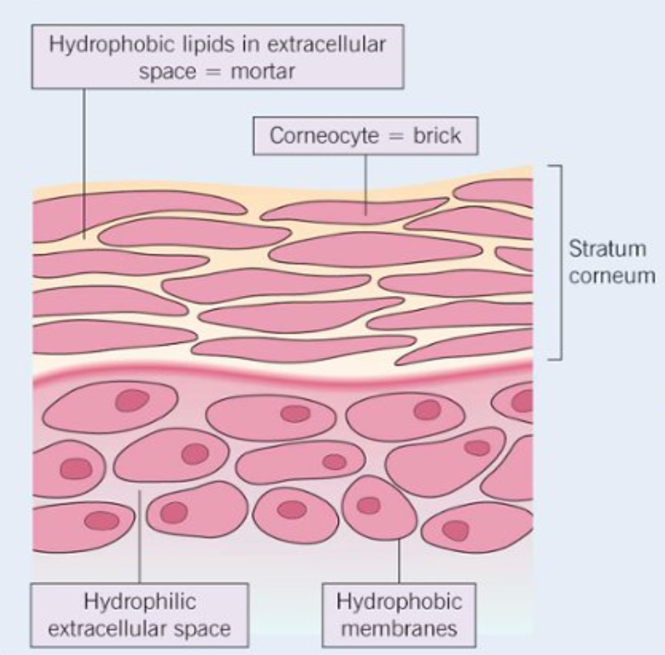
Skin barrier – more than just “mortar and brick”
Purported influencing factors
Not a static physical structure
Filaggrin: maintain cornified envelope, promotes keratin aggregation, regulation of skin pH, breakdown products have water-binding capacity (natural moisturizing factor)
Inflammation can decrease expression of filaggrin
Changes in external humidity regulate proteolysis of filaggrin, epidermal DNA/lipid synthesis, and initiation of inflammation
Changes in pH can alter maturation of lamellar bodies
Alterations in barrier ➔ increased transepidermal water loss, increased penetration of environmental allergens, infection, AD
Fernanda Schmidt, M.D.

Slide 9
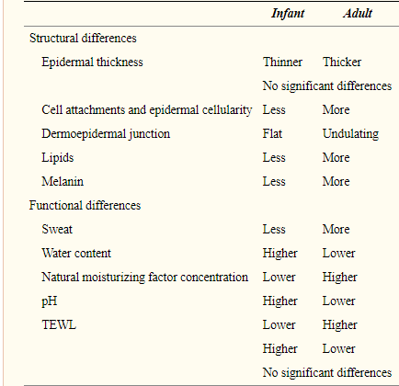
Structural and functional differences between infant and adult skin
Oranges T, Dini V, Romanelli M
Fernanda Schmidt, M.D.

Slide 10
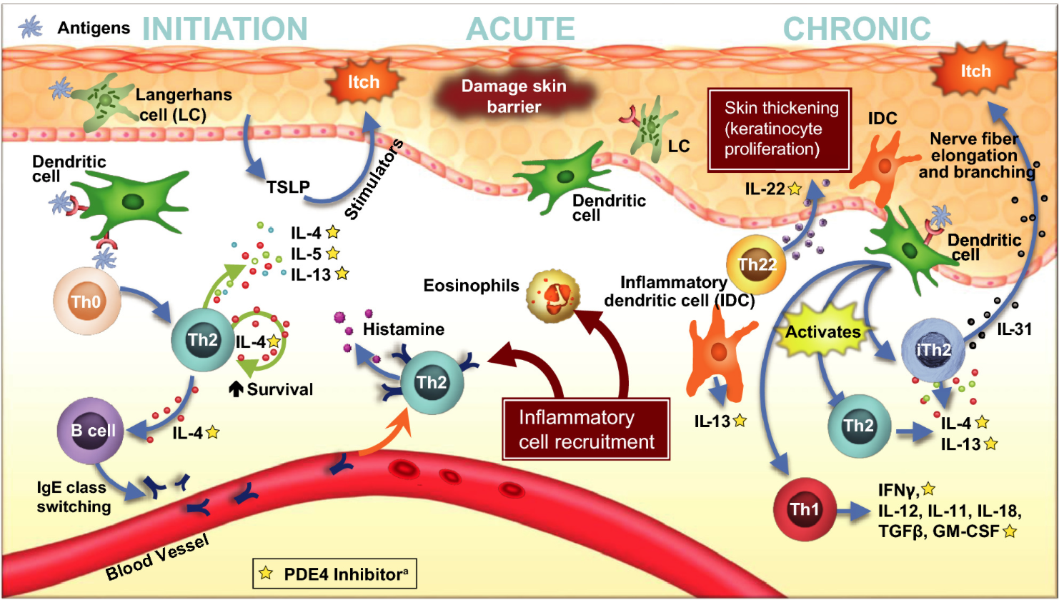
Immune pathways associated with AD
Clin Rev Allergy Immunol. 2020 Jan 9. doi: 10.1007/s12016-019-08775-4.Actas Dermosifiliogr. 2020 Jan 20. pii: S0001-7310(19)30389-8.
Experimental Dermatology, Volume: 28, Issue: 1, Pages: 3-10, First published: 17 October 2018, DOI: (10.1111/exd.13808)
David E. Cohen, M.D.

Slide 11
Emerging AD Treatments & Associated Pathways
Th2
Lebrikizumab
JAK/STAT signaling
Baricitinib
Tralokinumab
Upadacitinib
Abrocitinib
ASN002
Tofacitinib,
Ruxolitinib,
Delgocitinib
Nemolizumab
Th22, Th17, and other intracellular processes
Fezankizumab
Secukinumab
PDE
Tapinarof
Th: T-helper cell; IL: interleukin; JAK: janus kinase;
STAT: JAK/signal transducer and activator of transcription
Ann Allergy Asthma Immunol 124 (2020): 28-35. doi: https://doi.org/10.1016/j.anai.2019.10.005
David E. Cohen, M.D.

Slide 12
Overall Summary of AD
As our understanding of the pathophysiology of AD gets further elucidated, the capacity to target new mechanisms improves.
Newer therapies offer the opportunity for more targeted approaches with potentially fewer adverse events.
David E. Cohen, M.D.

Slide 13
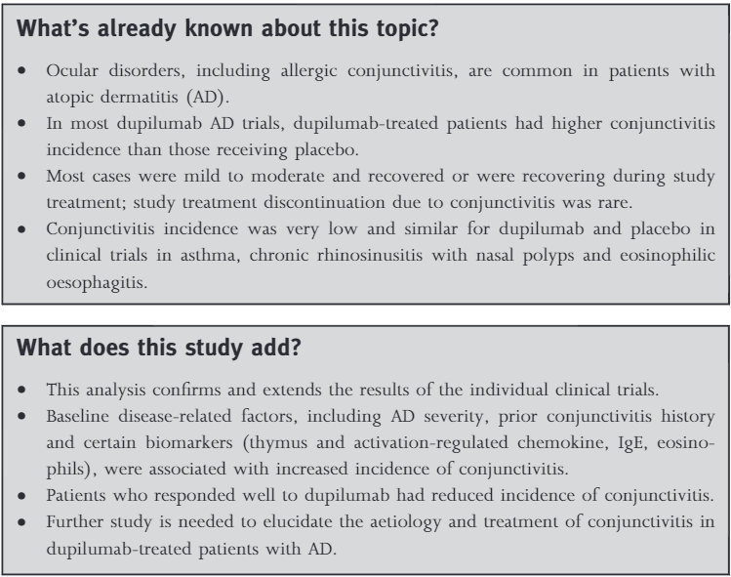
Dupilumab – Caution Required
Leon H. Kircik M.D.

Slide 14
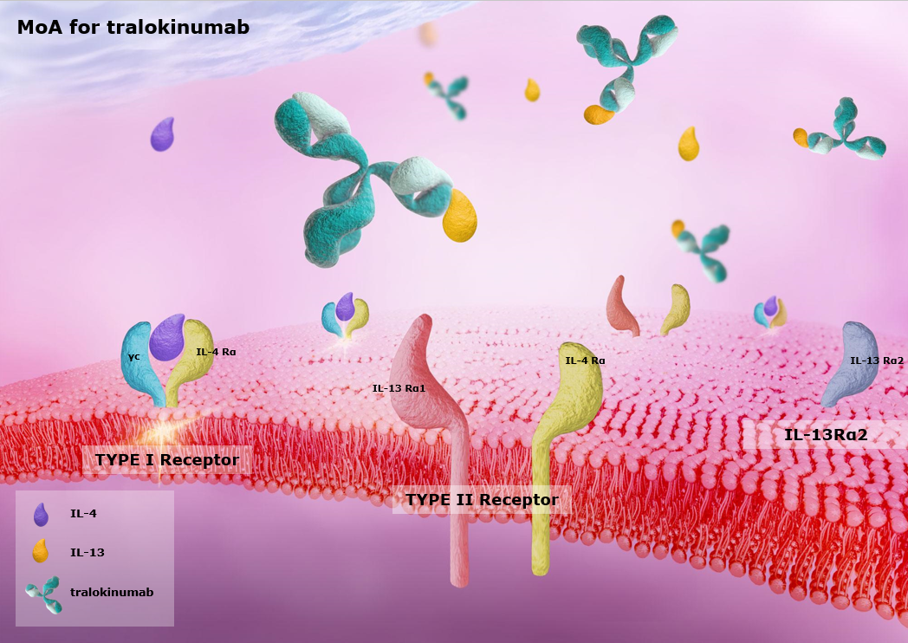
Tralokinumab
¹⁻⁴
Tralokinumab is a fully human, immunoglobulin (Ig)G4 monoclonal antibody that potently and specifically binds to and neutralizes the effects of IL-13¹
1. Popovic et al. J Mol Biol 2017;429:208–219; 2. May et al. Br J Pharmacol 2012;166:177; 3. Thom et al. Methods Mol Biol 2012;805:393; 4. Thom et al. PNAS 2006; 103 (20):7619
Leon H. Kircik M.D.

Slide 15
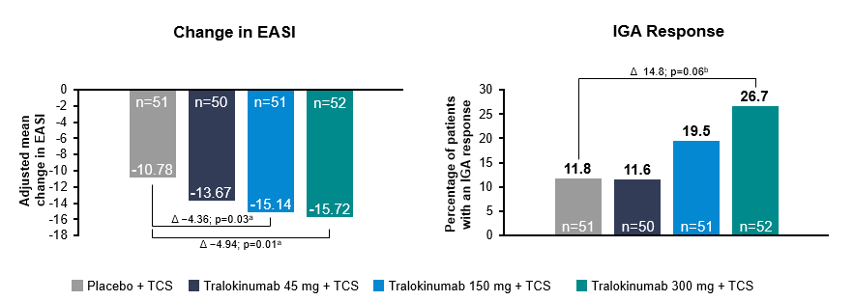
Tralokinumab
Tralokinumab improved the extent and severity of atopic dermatitis
ap-value for the adjusted mean difference compared with placebo; bp-value for the adjusted percentage difference compared with placebo
EASI, Eczema Area and Severity Index; IGA, Investigator’s Global Assessment; TCS, topical corticosteroid
Adapted from Wollenberg et al. J Allergy Clin Immunol 2018, Article in press. DOI: 10.1016/j.jaci.2018.05.029.
Leon H. Kircik M.D.

Slide 16
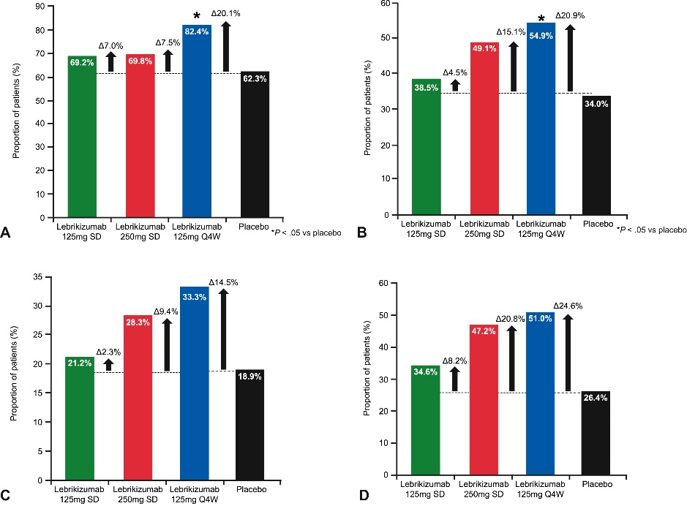
Lebrikizumab
Proportion of atopic dermatitis patients achieving (A) a 50% reduction of Eczema Area and Severity Index, (B) a 75% reduction of Eczema Area and Severity Index, (C) an Investigator Global Assessment of 0 or 1, and (D) a 50% reduction of SCORing Atopic Dermatitis at week 12 of lebrikizumab treatment. Q4W, Every 4 weeks; SD, single dose.
Leon H. Kircik M.D.

Slide 17
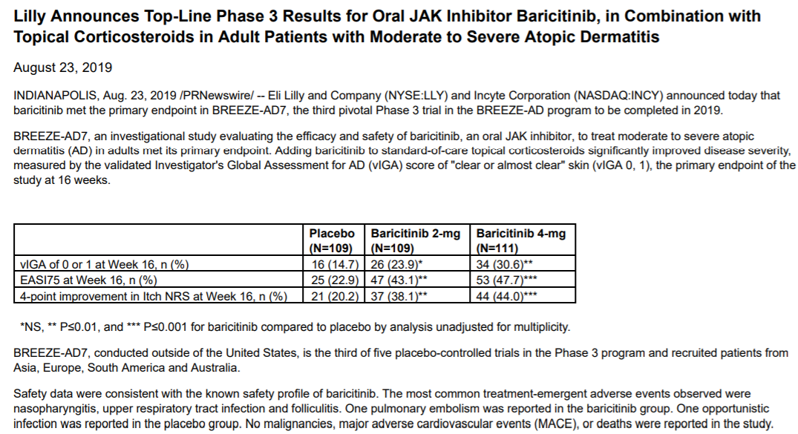
JAK/STAT Signaling Pathways
BARICITINIB
"Lilly Announces Top-Line Phase 3 Results for Oral Jak Inhibitor Baricitinib, in Combination with Topical Corticosteroids in Adult Patients with Moderate to Severe Atopic Dermatitis." 2019. Print.
Leon H. Kircik M.D.

Slide 18
JAK/STAT Signaling Pathways
UPADICITINIB
Adapted from Marjolein S de Bruin-Weller presentation at 2018 International symposium on Atopic Dermatitis
Leon H. Kircik M.D.

Slide 19
A Greater Proportion of Patients Achieved a Response at Week 12 With the 100-mg and 200-mg Doses
JAK/STAT Signaling Pathways
ABROCITINIB
Primary End Point: IGA Responseª at Week 12
 | Placebo | 10 mg | 30 mg | 100 mg | 200 mg
Response | 6.3% | 8.2% | 12.3% | 27.8% | 44.5%
95% CI | -0.2-12.9 | 2.2-14.1 | 4.9-19.7 | 14.8-40.9 | 26.7-62.3
P value | — | 0.1210 | 0.1065 | 0.0184 | 0.0032
* P = 0.0184
** P = 0.0032
CI, confidence interval; E_{max}, the difference between maximum achievable response (at infinite dose) and baseline; FAS, full analysis set; IGA, Investigator’s Global Assessment; NRI, nonresponder imputation; SE, standard error.
ªEmax fitted curve with SE. Baseline was defined as last measurement before first dosing. IGA response was defined as a score of clear (0) or almost clear (1) with a ≥2-point improvement from baseline at week 12 (FAS, NRI). For discontinued subjects, any missing value for all subsequent visits until week 12 was imputed using the NRI approach. Bars indicated SE.
Leon H. Kircik M.D.

Slide 20
Delgocitinib
Pan-JAK inhibition
Phase 3 trial: mEASI and IGA responses with topical delgocitinib among patients with moderate to severe AD
Leon H. Kircik M.D.

Slide 21
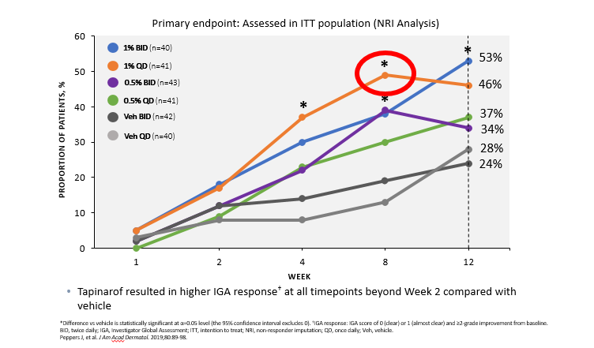
Topical Tapinarof
Therapeutic Aryl Hydrocarbon Receptor Modulating Agent
Leon H. Kircik M.D.

Slide 22
Atopic Dermatitis
A disease of the whole family
No patient should leave the office without an instructional handout with the therapeutic ladder
If your stable atopic patient is flaring, think:
STAPH
STAPH
STAPH
New therapies
Lawrence Schachner M.D.

Slide 23
Avoiding Treatment Pitfalls
Printed regimen goes home: NO HANDOUT, NO COMPLIANCE
AD Made EZ: Easy sliding scale treatment tree
2 minutes of education
2 minutes of treatment explanation
When in doubt: Dx/Rx infection.
Give adequate volumes of medication
Supply and refills for ACUTE AND MAINTENANCE treatment.
The whole family is the patient: psychosocial intervention when necessary.
Lawrence Schachner M.D.

Slide 24
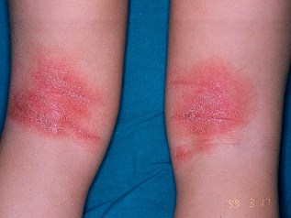
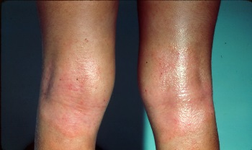
The Schachner Ladder
Severity | Topical Treatment | Schedule
If Severe: | Clobetasol (high potency CS) + TCI or PDI + emollients | Twice daily for 3-5 days
If Moderate: | Triamcinolone (medium potency CS) + TCI or PDI + emollients | Twice daily for 3-5 days
If Mild: | Alclometasone (low potency CS) + TCI or PDI + emollients | Twice daily for 3-5 days
Controlled: | TCI or PDI or TS + emollients | Twice daily for 2 weeks
Maintenance (to areas of predilection): | TCI or PDI or TS + emollients | Twice weekly for 6 months
Long-term Maintenance & Prevention: | Emollients | Twice daily
*Abbreviations: CS: Corticosteroid. PDI: Phosphodiesterase inhibitor. TCI: Topical Calcineurin Inhibitor
Oberlin KE, Nanda S. Atopic dermatitis made easy: The Schachner Ladder. Pediatr Dermatol. 2019;36(6):1017-8.
Lawrence Schachner M.D.

Slide 25
Algorithm For The Treatment Of Moderate To Severe Atopic Dermatitis
If successful
Titrate down
If unsuccessful
Patch testing
TCI's 2x a week or role for PDI or topical steroid
Emollients only
Tar
Class I-II topical steroids
Prednisone
DUPILUMAB
IVPS
UVA, UVB, narrowband UVB
Cytotoxic and Biologic agents: cyclosporine, cellcept, cyclophosphamide, azathioprine, methotrexate
INF α or γ subcutaneously
IVIG
Relaxation / Massage therapy / Behavioral/ Probiotics
Lawrence Schachner M.D.

Slide 26
Crisaborole
First topical Phosphodiesterase 4 inhibitor (PDE-4)
U.S. FDA approved in December 2016 for mild-moderate atopic dermatitis in patients 2 years of age and older
Mechanism of action: by inhibition PDE-4, results in increase intracellular cAMP levels which is suppression the release of pro-inflammatory cytokines
Crisaborole ointment 2% apply twice daily supplies in 60 g and 100 g tube.
J Pharmacol Exp Ther. 2001;299:753-759
Inflamm Allergy Drug Targets 2007 Mar;6(1):17-26.
Lawrence Schachner M.D.

Slide 27
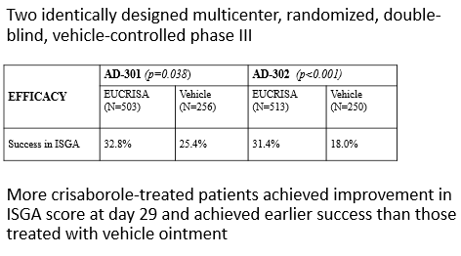
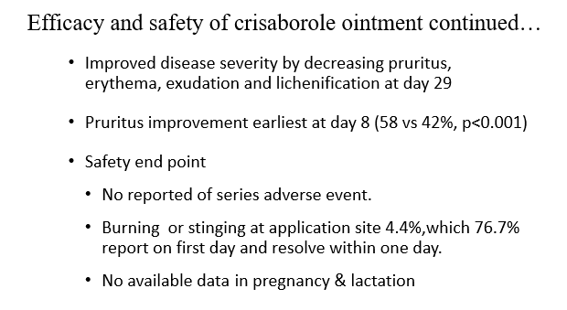
Efficacy and safety of crisaborole ointment, a novel, nonsteroidal phosphodiesterase 4 (PDE4) inhibitor for the topical treatment of atopic dermatitis (AD) in children and adults
Paller et al. J Am Acad Dermal 2016;75:494-503
Lawrence Schachner M.D.

Slide 28
Dupilumab
Dupilumab is a successful currently available biologic treatment of a moderate to severe Atopic Dermatitis (AD)
It is a fully human monoclonal antibody directed against the shared alpha subunit of the IL-4 receptor resulting in signaling blockade of IL-4 and IL-13, which are key drivers of Th2-mediated inflammation of AD
Suppresses the expression of genes related to the activation of Th2 cells and related inflammatory pathways, a major driver in AD clinical disease
Indications:
Moderate to severe AD not responding to topical treatment (as monotherapy or in combination with topical steroids) in 12 year olds and up.
Dose: 300 mg subq/ 200 mg subq…60 kg. Dupixent comes in a pre-filled syringe and can be self-administered as a subcutaneous injection every other week after an initial loading dose (600mg) . It can be used with or without topical corticosteroids.
An open label multicenter extension study revealed a favorable long-term (> 1 year) safety and efficacy profile in adults
Recently in May 2020, Dupilumab got FDA approval for the treatment of moderate to severe atopic dermatitis in children aged 6 to 11 years (POST 2020 MOPD)
Clark et al. Cutis. 2018 Sep;102(3):201-204.
Deleuran M, et al. J Am Acad Dermatol. 2020 Feb;82(2):377-88.
Igelman S, et al. J Am Acad Dermatol. 2020 Feb;82(2):407-11.
Lawrence Schachner M.D.

Slide 29
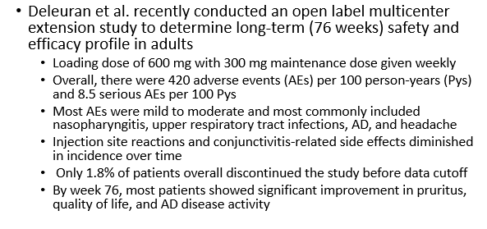
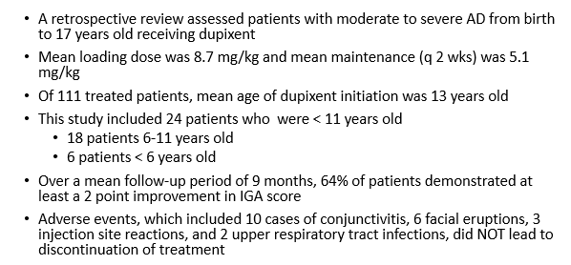
Dupilumab: Safety and Efficacy Studies
Igelman S, Kurta AO, Sheikh U, McWilliams A, Armbrecht E, Jackson Cullison SR, et al. Off-label use of dupilumab for pediatric patients with atopic dermatitis: A multicenter retrospective review. J Am Acad Dermatol. 2020;82(2):407-11.
Lawrence Schachner M.D.

